Slide 1

Energy Reporting 101
K Kaufmann
E/lectrify: electrifynews.beehiiv.com/
kkaufmanndc@gmail.com

Slide 2
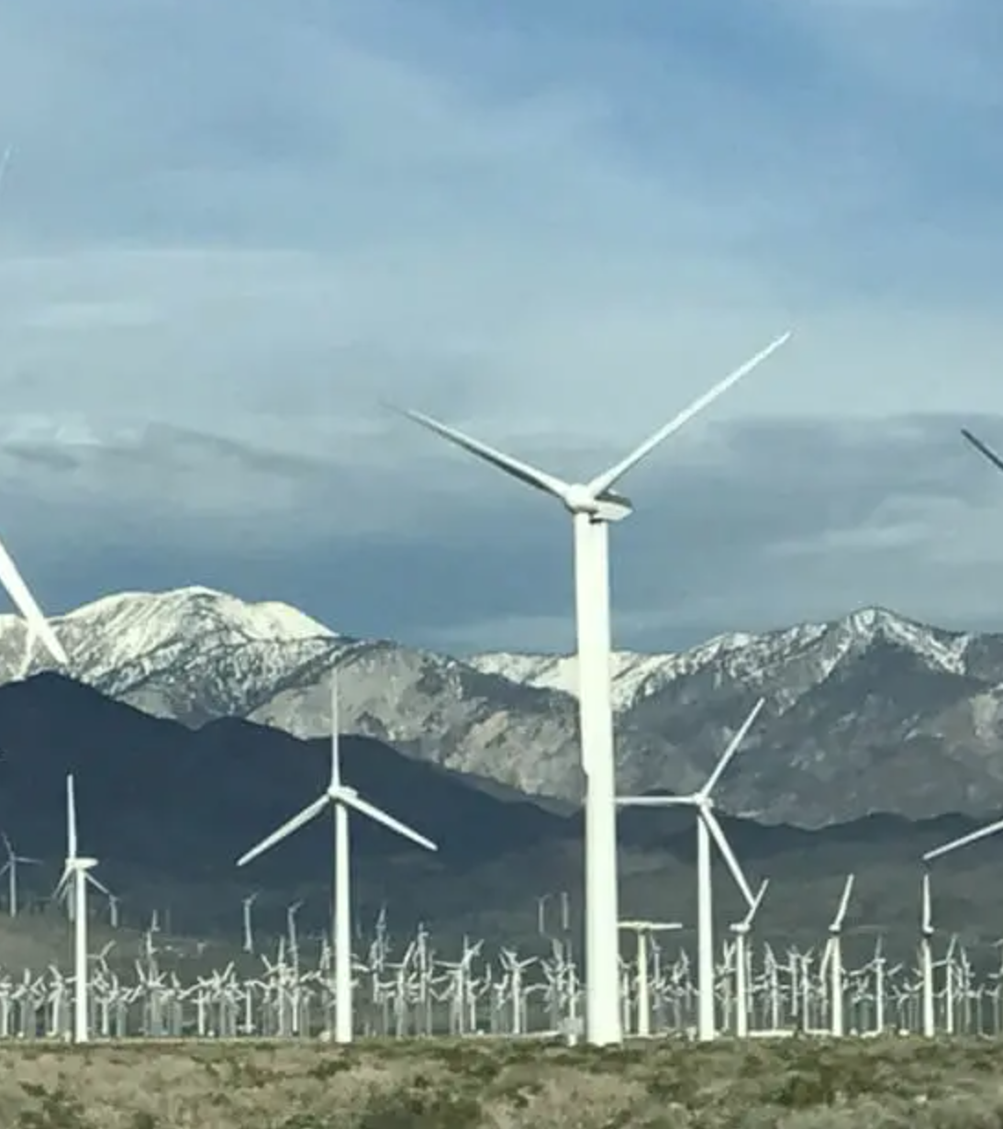
The first things you need to know
Every form of electricity generation and clean technology has environmental, economic and social impacts that involve tradeoffs.
The tradeoffs that are socially and politically acceptable will change over time and geography.

Slide 3
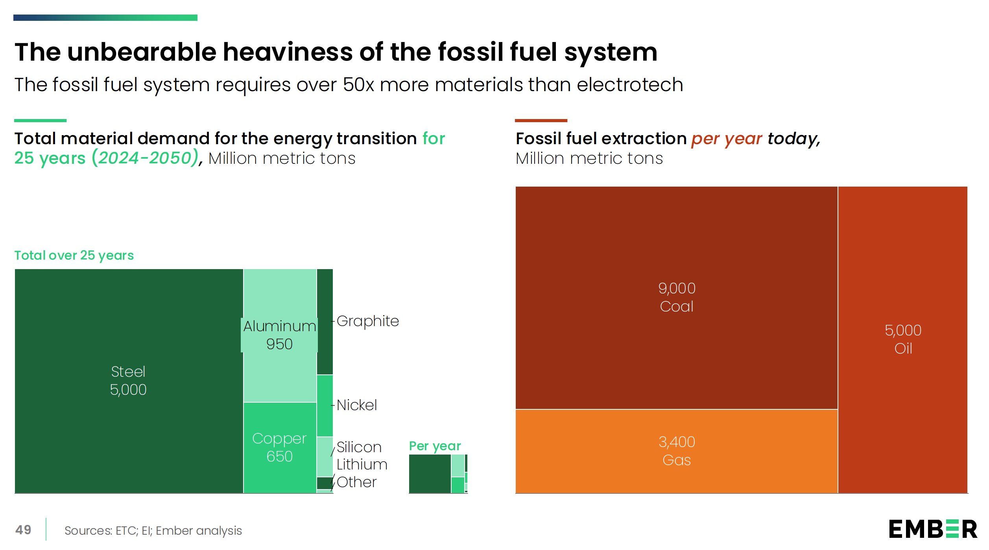

Slide 4
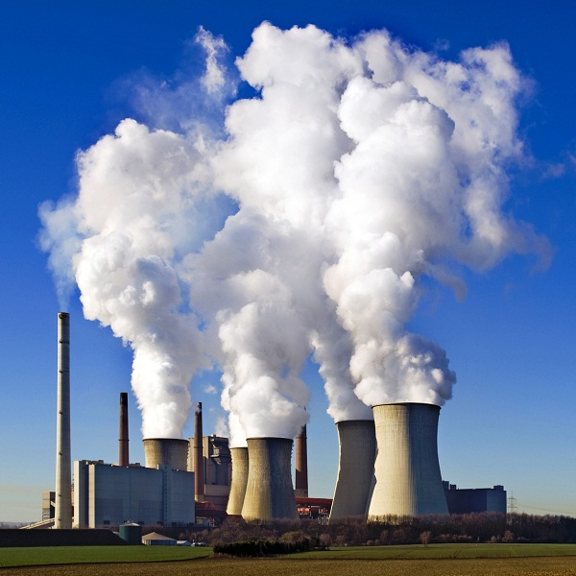
Stories on the ground
Natural gas/coal plants (PJM, DOE, etc.)
Local solar permitting/plug-in solar/DERs
Land use/agrivoltaics
Affordability/environment connections
Global perspectives: U.S. as secondary/isolated market

Slide 5
Resources
Interconnection.fyi: https://www.interconnection.fyi/
Halcyon: halcyon.io
DSIRE (Database for State Incentives for Renewable Energy: desireusa.org
The Electrotech Revolution: https://ember-energy.org/latest-insights/the-electrotech-revolution/

Slide 6
Shameless self-promotion slide
RTO Insider: Why Chris Wright Is so Wrong
E/lectrify Energy Literacy series
  Utilities
  Utility commissions
  RTOs and ISOs (grid operators)
  Inertia
  Distributed energy resources (DERs)
    Part 1
    Part 2

